Slide 1



INTRODUCTION TO FINANCIAL ENGINEERING
OPTION PRICING

Slide 2

Team 16
ADARSH RAJ SHRIVASTAVA (B21AI003)
ASHUTOSH (B21AI007)
PRAKHAR GUPTA (B21AI027)
SALONI GARG (B21AI036)

Slide 3

Outline
Used AAPL stock.
Used YAHOO finance for stock history
Use past one-year data to estimate the annual volatility.
Uses 10 years’ US treasury rate as the rate of interest.
Evaluated Binomial for different strike prices and time of maturity to evaluate the call/ put option.
Evaluated Black Scholes for different strike prices and time of maturity to evaluate the call/ put option.
Showed convergence of Black Scholes and Binomial for large n
Comparison with the actual market data
Created a delta neutral portfolio
Used numerical methods to get implied volatility.

Slide 4

Procedure
Data Sources and Overview
Used AAPL stock:
We chose Apple Inc. (AAPL) as our underlying stock for this project.
Used YAHOO finance for stock history:
For collecting historical stock data, we utilized Yahoo Finance's API.
We downloaded data from March 28, 2023, to April 1, 2024, for AAPL stock.

Slide 5
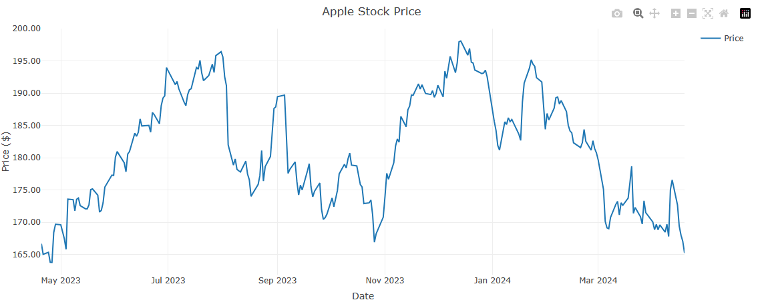
Stock - AAPL

Slide 6

Interest Rate
Used 10 years’ US treasury rate as the rate of interest
r = 4.518%

Slide 7
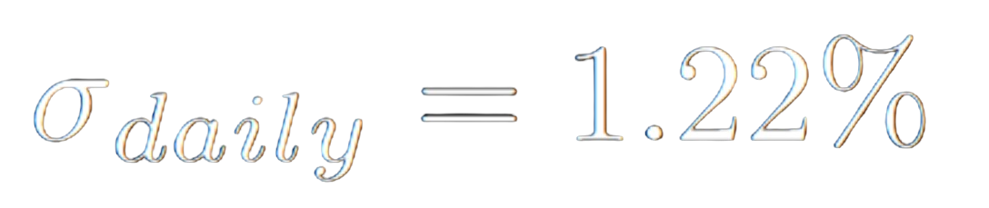
Volatility

Slide 8
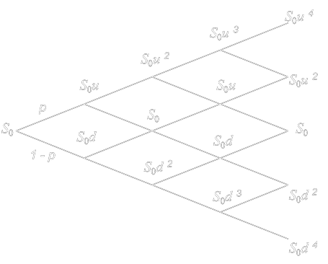
Binomial Model
The binomial option pricing model assesses options by employing an iterative method that involves multiple periods to determine their value.
Within this model, each iteration results in two potential outcomes – an upward movement or a downward movement following a binomial tree.

Slide 9
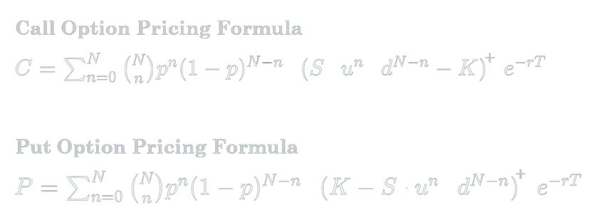

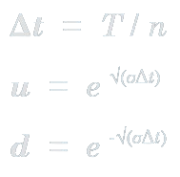
Or
Use Put-Call Parity

Slide 10
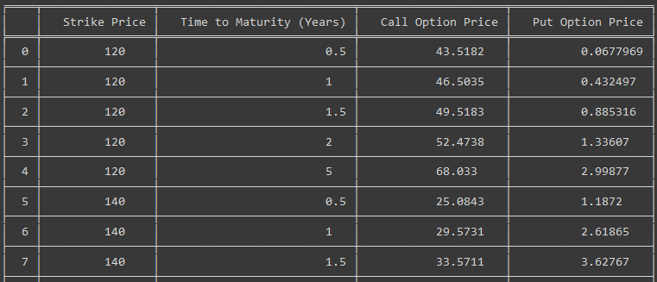

Slide 11
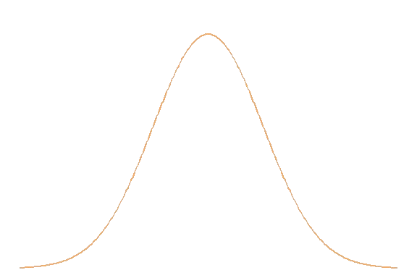
Black Scholes Model
The model considers five key components:
The price of the underlying asset.
The strike price of the option.
The time to expiration.
The risk-free interest rate, and
The volatility of the underlying asset's returns.
The Black-Scholes model provides a theoretical framework for pricing options.

Slide 12
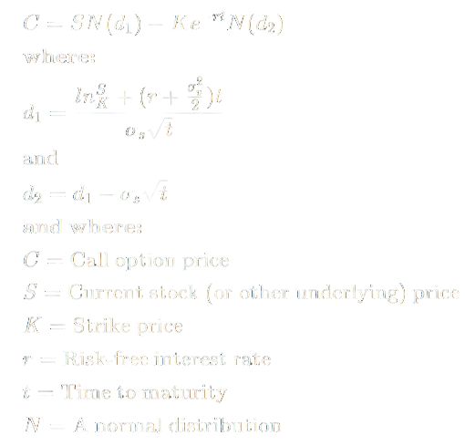
To find P
Use Put-Call Parity

Slide 13
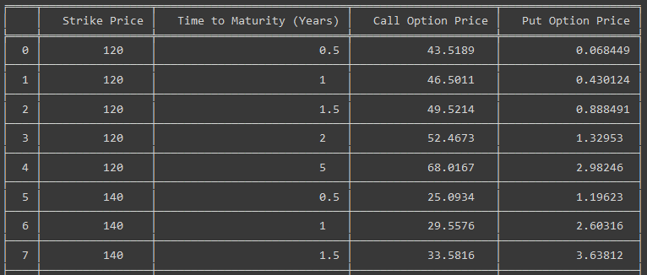

Slide 14
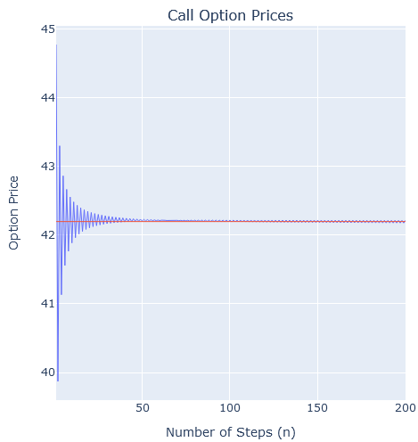
Convergence
Increasing the number of time steps (nn) in the binomial model leads to finer granularity and smaller time intervals between steps.
This finer granularity results in the binomial model approaching the continuous-time dynamics assumed by the Black-Scholes model, indicating convergence between the two models.

Slide 15
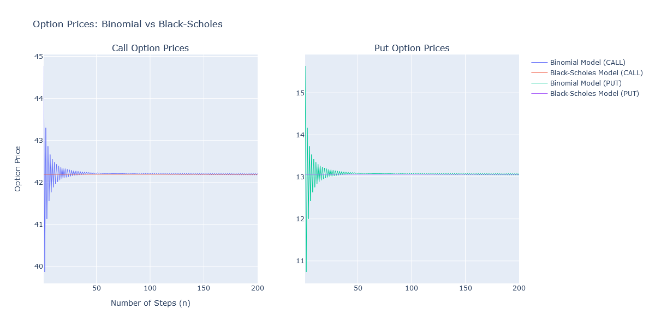

Slide 16
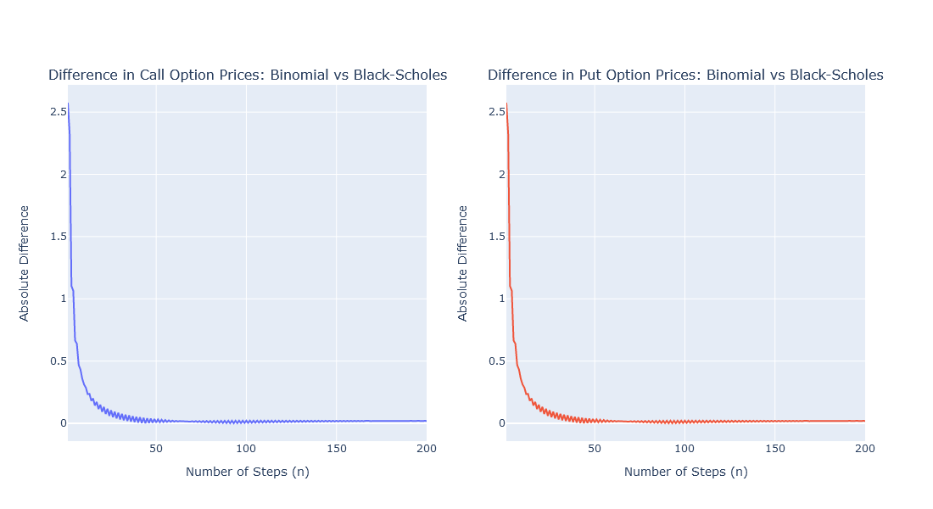

Slide 17
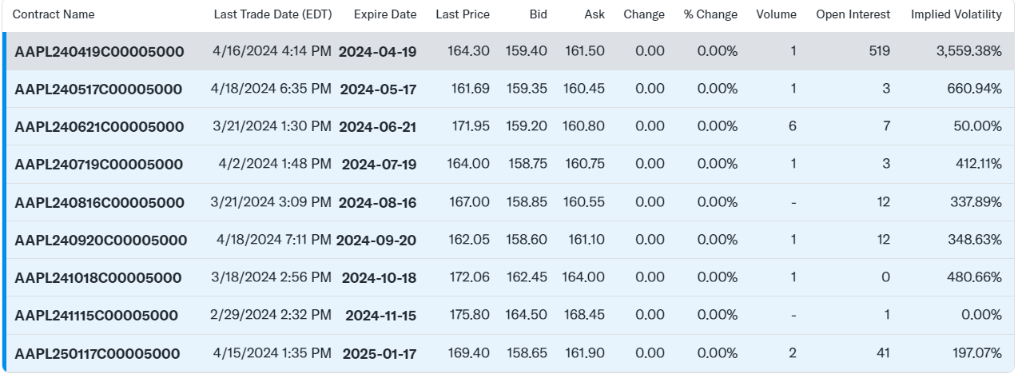
Comparison with Actual Market
Applying Black scholes and Binomial model on the dataset of options (collected from YahooFinance)
Period of maturity = ExpireDate - LastTradeDate (In days)
Steps of Binomial Model = 1 day

Slide 18
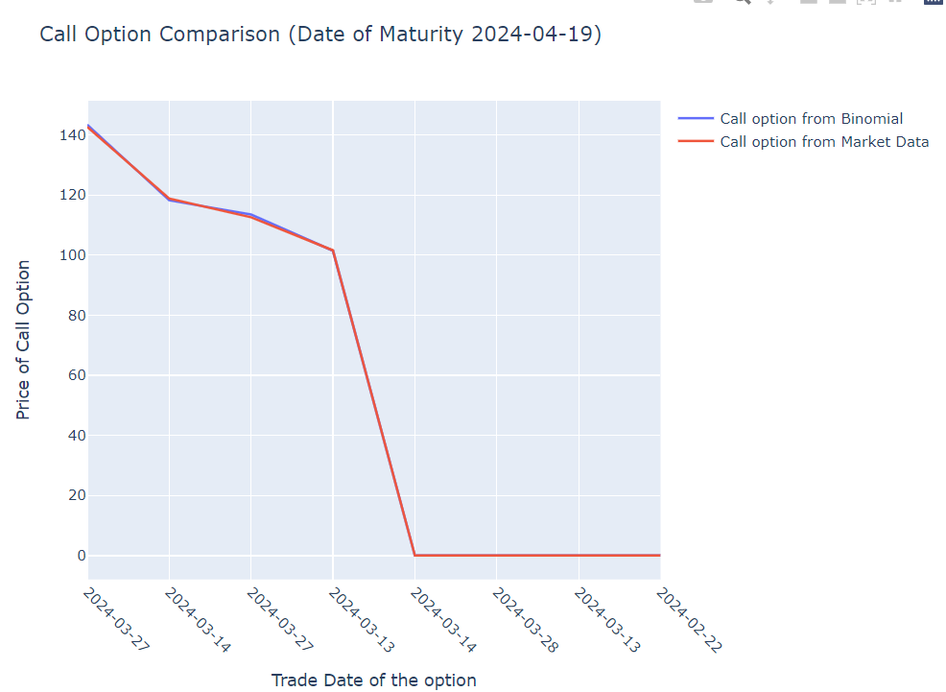
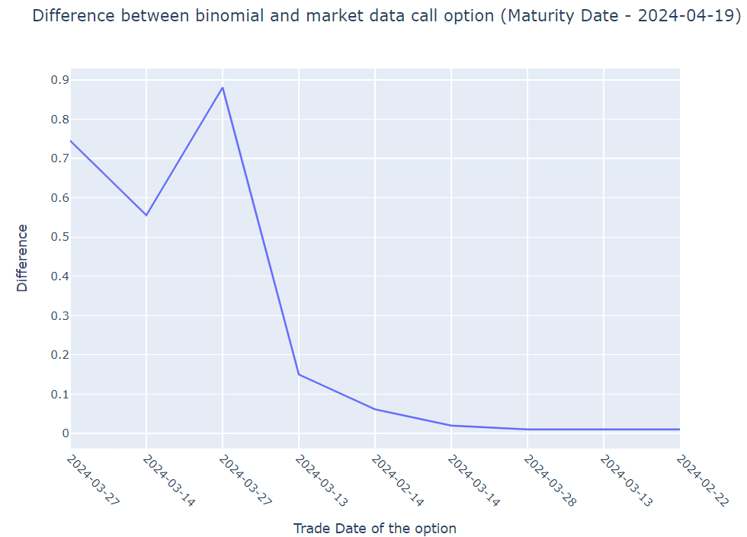
Comparison with Actual Market
Call Option using Binomial Model

Slide 19
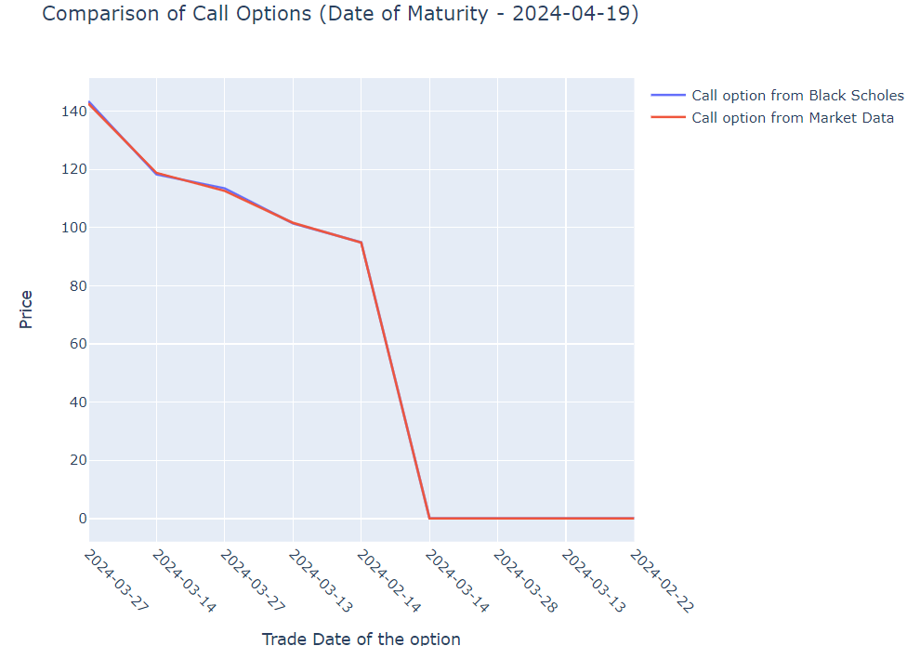
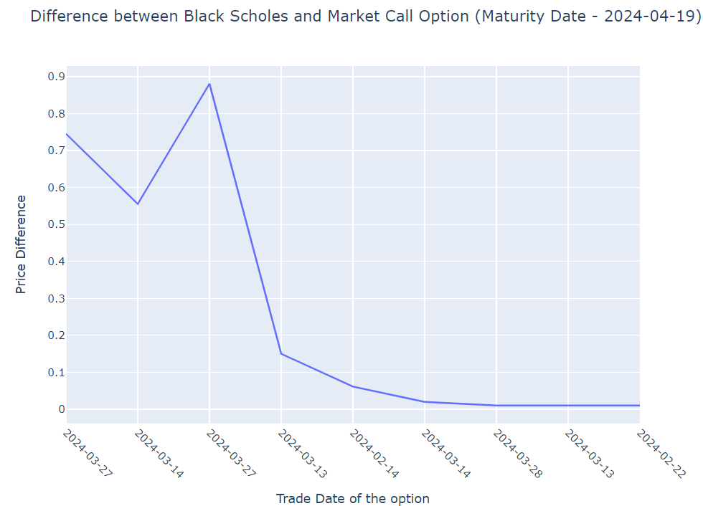
Comparison with Actual Market
Call Option using Black Scholes Model

Slide 20
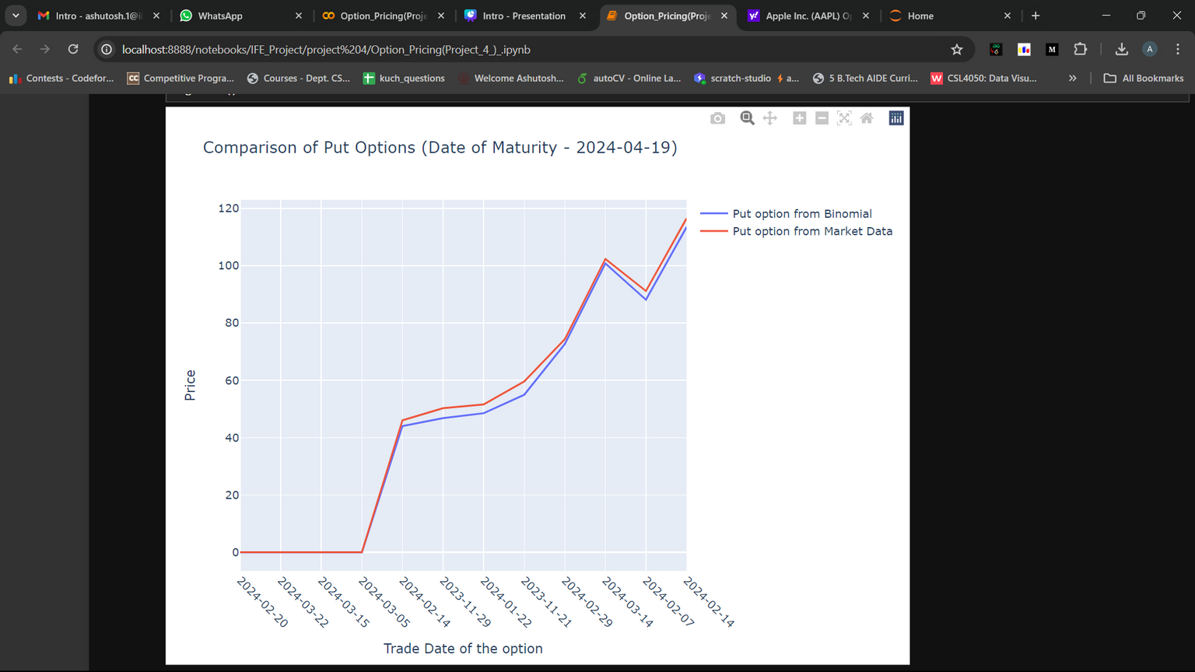
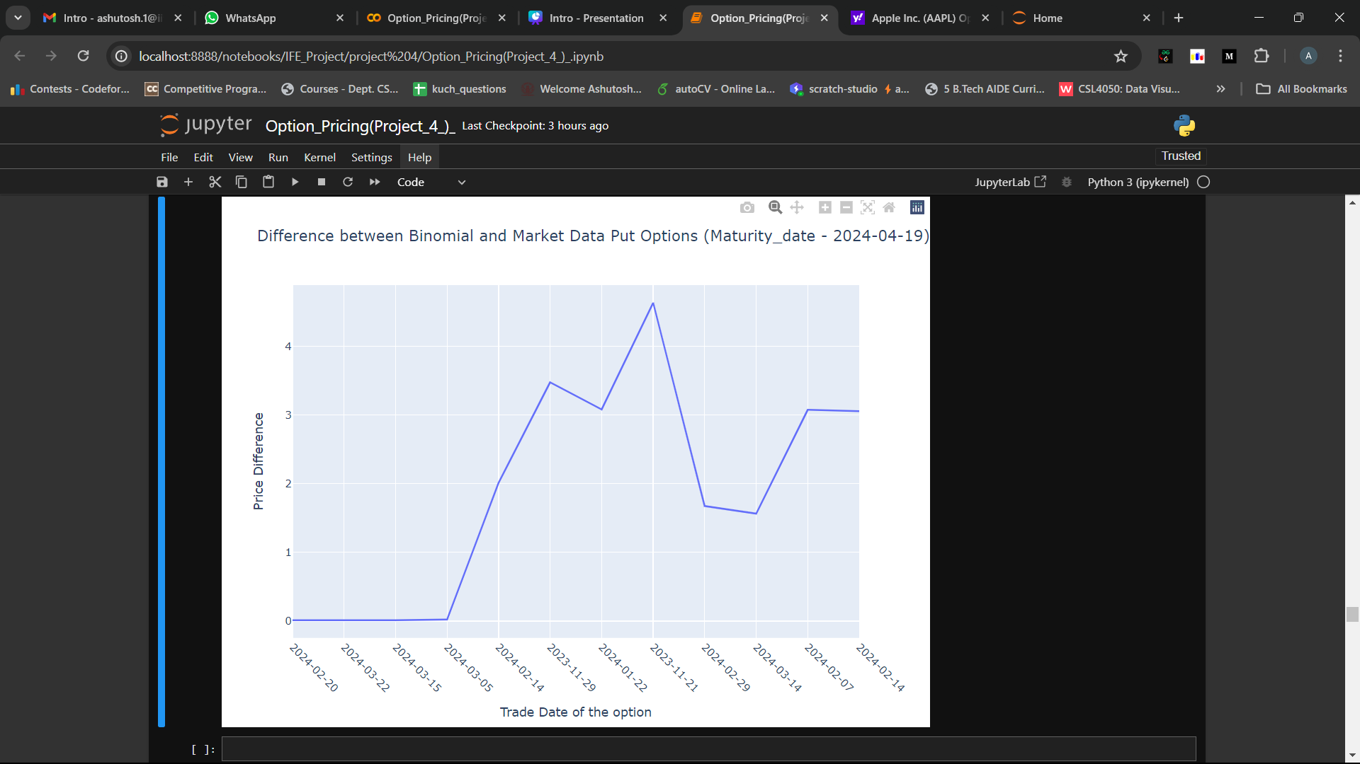
Comparison with Actual Market
Put Option using Binomial Model

Slide 21
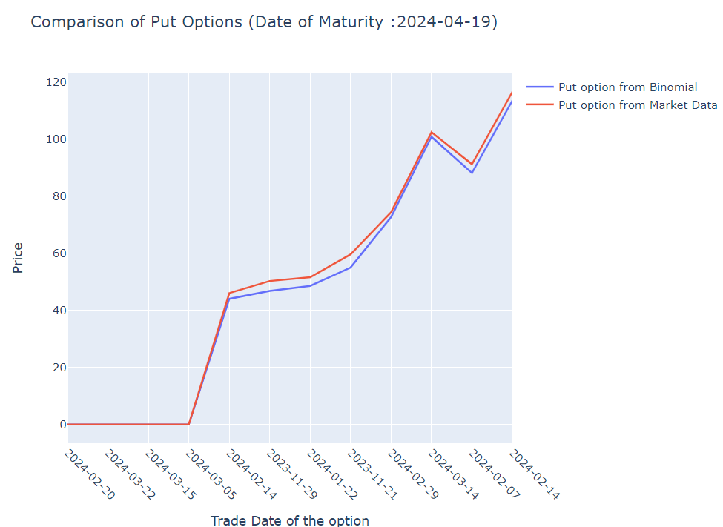
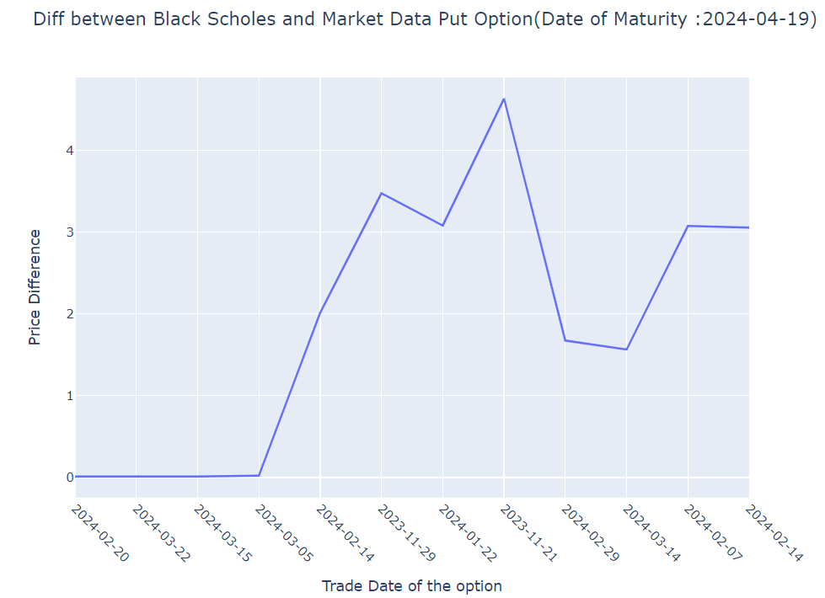
Comparison with Actual Market
Put Option using Black Scholes Model

Slide 22
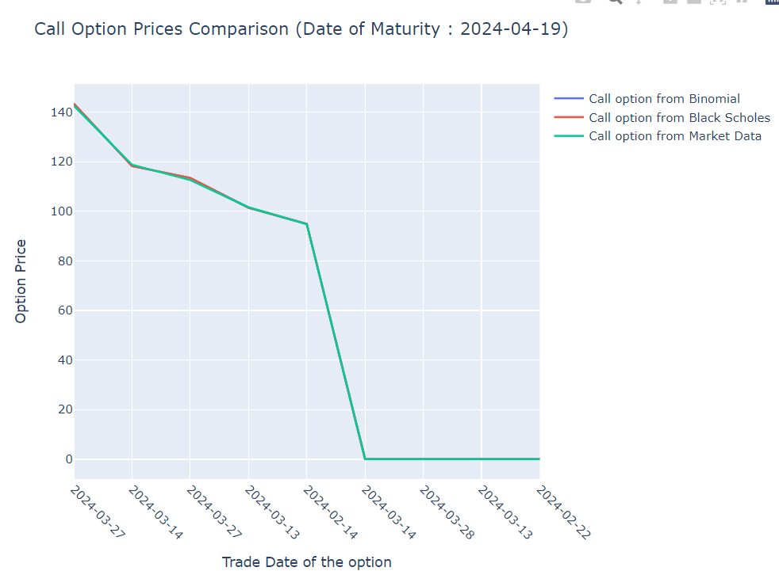
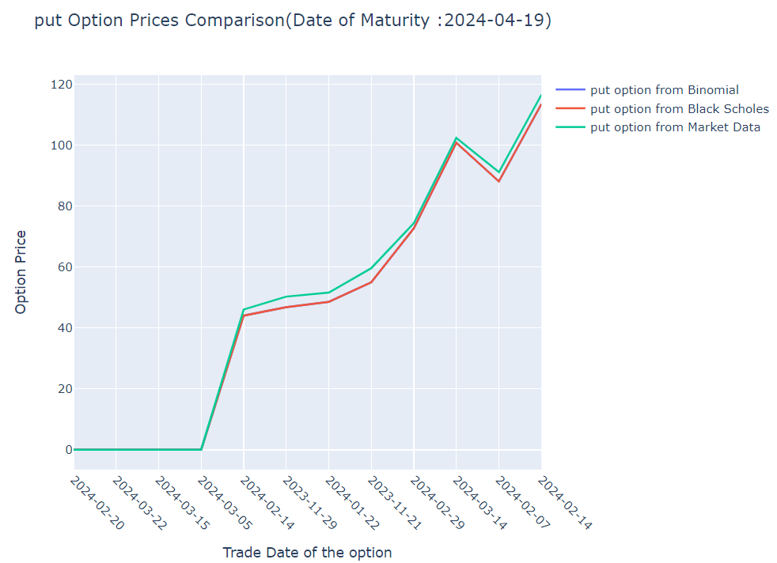
Comparison with Actual Market
Binomial vs Black Scholes vs Actual Market

Slide 23
Comparison with Actual Market
Conclusion
With a combination of shorter time to expiration and a sufficiently large number of steps in the binomial model, the practical difference between the two models becomes negligible.
Black-Scholes and Binomial models are really good at predicting prices, which makes them valuable tools for making decisions in finance today.
This shows that Binomial and Black-Scholes are applicable in actual market conditions and real world trading.

Slide 24

Delta Neutral Portfolio
Delta neutral is a portfolio strategy that uses multiple positions to balance positive and negative deltas so the overall delta of the assets totals zero.
A delta-neutral portfolio evens out the response to market movements for a certain range to bring the net change of the position to zero.

Slide 25
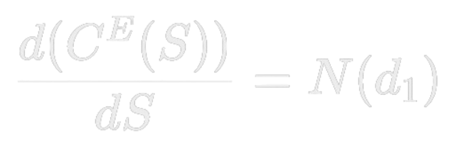
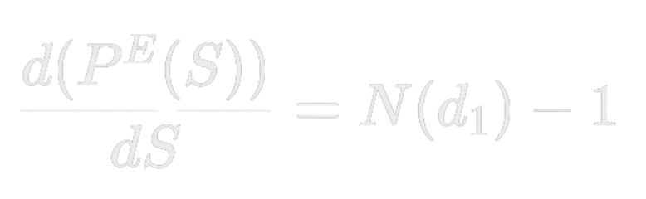
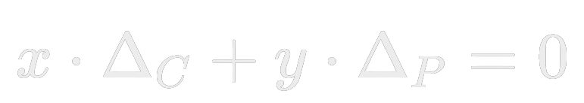
Neutralizing using options only
For Black Scholes model,

Slide 26
Call options
Put options
Strike (K) | Time to Maturity (T in days) | Call Delta | Portfolio (number of put options)
30 | 23 | 0.999742 | 38731.2
55 | 36 | 0.998498 | 6648.62
60 | 23 | 0.996792 | 3107.03
70 | 37 | 0.997174 | 3528.12
90 | 65 | 0.999097 | 11065.1
Strike (K) | Time to Maturity (T in days) | Put Delta | Portfolio (number of call options)
65 | 59 | -0.000626 | 0.0062663
70 | 28 | -0.00432 | 0.0433755
75 | 35 | -0.00367 | 0.0368403
85 | 45 | -0.00299 | 0.0299823
230 | 65 | -0.00588 | 0.059131

Slide 27
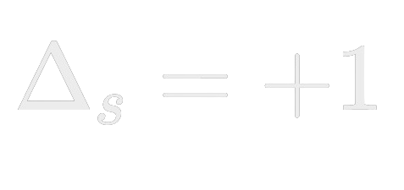

Neutralizing using options and number of shares
Let’s suppose we own 100 shares of AAPL stocks, now to neutralize the delta we need to buy Put options.

Slide 28
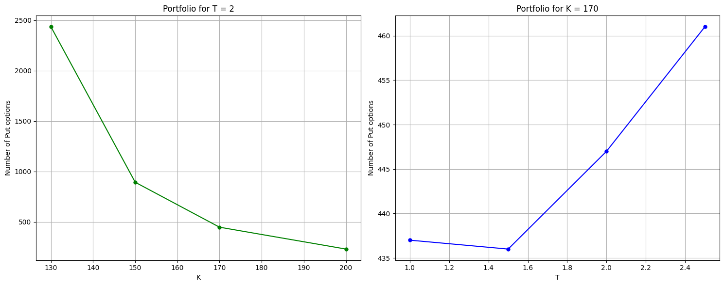

Slide 29
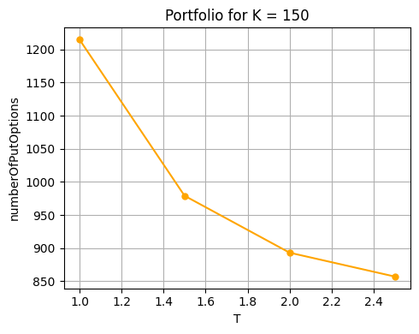

Slide 30
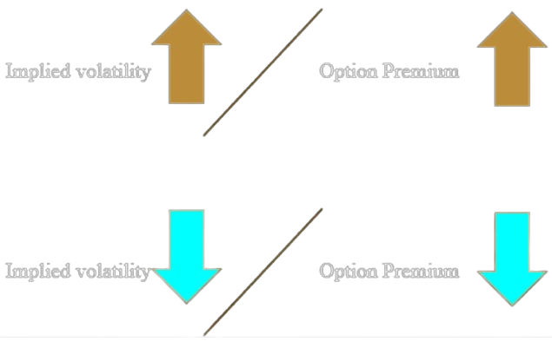
Implied Volatility
IV is often used to price options contracts where high implied volatility results in options with higher premiums and vice versa.
Implied volatility usually increases in bearish markets and decreases when the market is bullish.

Slide 31

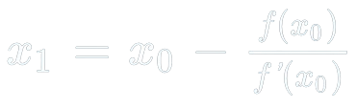
Numerical Method
We need to solve for σ
For this we will use Newton-Raphson method

Slide 32
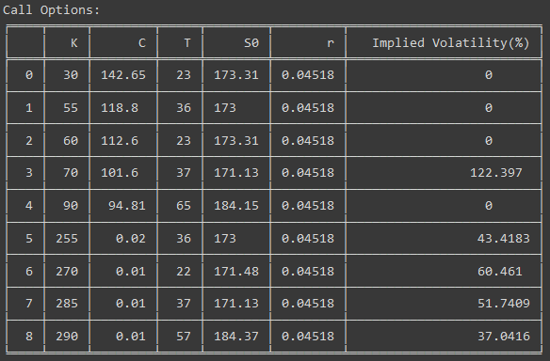

Slide 33
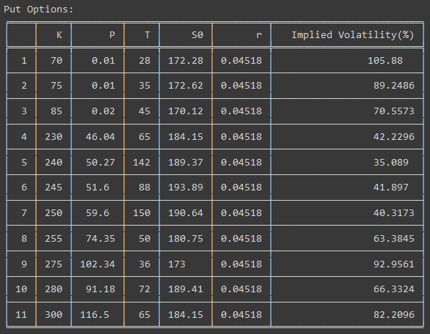

Slide 34
THANK YOU

